Slide 1

Artificial Intelligence
Ch1: Introduction
Instructor: Iyad Husni Alshami
[These slides adopted from Dan Klein and Pieter Abbeel at UC Berkeley ai.berkeley.edu]
Notes:
Please retain proper attribution, including the reference to ai.berkeley.edu. Thanks!

Slide 2
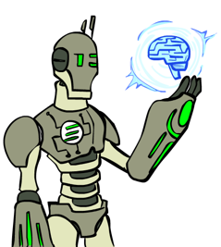
Today
What is artificial intelligence?
Where did it come from/What can AI do?
What should we and shouldn’t we worry about? What can we do about the things we should worry about?
What is this course?

Slide 3
Intelligence
the ability to acquire and apply knowledge and skills.
Google Dictionary
the capacity for abstraction, logic, understanding, self-awareness, learning, emotional knowledge, reasoning, planning, creativity, critical thinking, and problem-solving. More generally, it can be described as the ability to perceive/infer information, and to retain it as knowledge to be applied towards adaptive behaviors within an environment or context.
Wikipedia

Slide 4
Intelligence
We call ourselves Homo sapiens—man the wise—because our intelligence is so important Intelligence to us. For thousands of years, we have tried to understand how we think and act—that is, how our brain, a mere handful of matter, can perceive, understand, predict, and manipulate a world far larger and more complicated than itself.
Artificial Intelligence: A Modern Approach (4th Edition)

Slide 5
Intelligence
الذكاء مصطلح يشمل القدرات العقلية المتعلقة بالقدرة على التحليل، والتخطيط، وحل المشاكل، وبناء الاستنتاجات، وسرعة التصرف، كما يشمل القدرة على التفكير المجرد، وجمع وتنسيق الأفكار، والتقاط اللغات، وسرعة التعلم، كما يتضمن أيضا حسب بعض العلماء القدرة على الإحساس وإبداء المشاعر وفهم مشاعر الآخرين.
مع أن المفهوم العام السائد عند الناس للذكاء يشمل جميع هذه الأمور وربما جعلوها مرتبطة بقوة الذاكرة، إلا أن علم النفس يدرس الذكاء كميزة سلوكية مستقلة عن الإبداع، والشخصية، والحكمة وحتى قوة الحافظة المتعلقة بالذاكرة.
https://ar.wikipedia.org/wiki/%D8%B0%D9%83%D8%A7%D8%A1

Slide 6
Artificial Intelligence (AI)
the theory and development of computer systems able to perform tasks normally requiring human intelligence, such as visual perception, speech recognition, decision-making, and translation between languages.
Google Dictionary
The field of artificial intelligence, or AI, Artificial intelligence is concerned with not just understanding but also building intelligent entities—machines that can compute how to act effectively and safely in a wide variety of novel situations.
Artificial Intelligence: A Modern Approach (4th Edition)

Slide 7
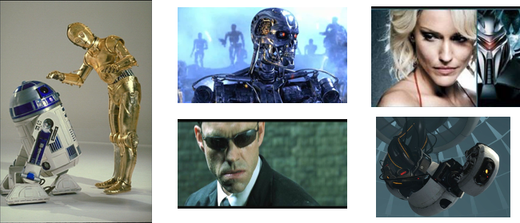
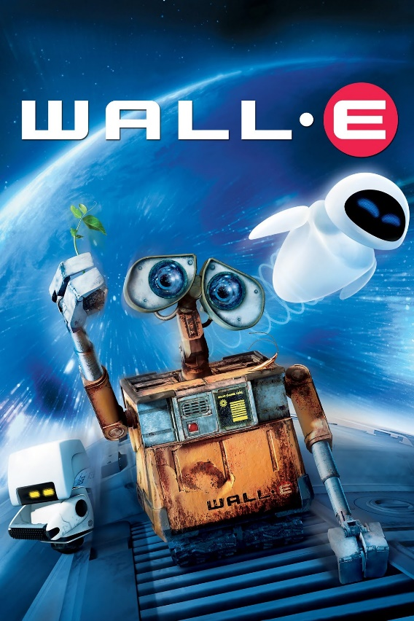
Sci-Fi AI?
Notes:
Who are these? C3PO, what does he do? Essentially google translate, (but with anxiety disorder!)
Small guy? R2D2 – what does he do, yeah, not so sure
Things got darker: machines come back from the future – to kill us!
90’s : software is scary
Basic fear about what technology might do ?
What if we can’t even tell technology apart from ourselves?
OR maybe it’ll look really different and snarky
Some exceptions like wall-E, positive view of technology (but maybe not of us humans!)
But mostly a worry
[not very worried myself, at least at present]

Slide 8
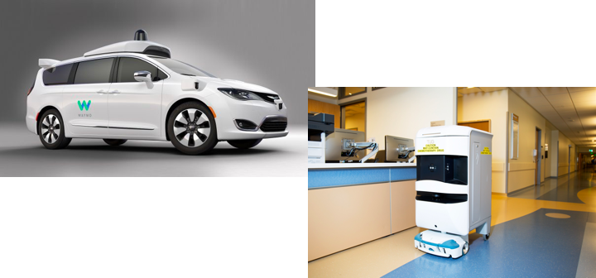
Reality of AI
An autonomous cars that figure out how to take us to our destination
Robots help nurses in hospitals deliver stuff to different rooms

Slide 9
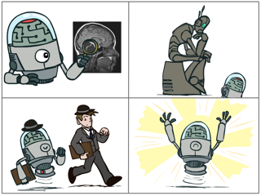
What is Artificial Intelligence (AI) ?
The science of making machines that:
Think like people
Think rationally
Act like people
Act rationally
Notes:
Natural intelligence -- Think like people – cognitive science, neuroscience
Act like people – actually very early definition, dating back to Alan Turing --- Turing test; problem to do really well you start focusing on things like don’t answer too quickly what the square root of 1412 is, don’t spell too well, and make sure you have a favorite movie etc. So it wasn’t really leading us to build intelligence
Think rationally – correct thought process -- long tradition dating back to Aristotle --- this is how to think so that you don’t make mistakes; but not a winner, because difficult to encode how to think / especially in the face of unknowns/uncertainty, and in the end it’s not about how you think, it’s about how you end up acting
Act rationally – an agent is just something that acts (agent comes from the Latin agere, to do). Of course, all computer programs do something, but computer agents are expected to do more: operate autonomously, perceive their environment, persist over a prolonged time period, adapt to change, and create and pursue goals. A rational agent is one that acts so as to achieve the best outcome or, when there is uncertainty, the best expected outcome.

Slide 10
Rational Decisions
We’ll use the term rational in a very specific, technical way:
Rational: maximally achieving pre-defined goals
Rationality only concerns what decisions are made
not the thought process behind them
Goals are expressed in terms of the utility of outcomes
Being rational means maximizing your expected utility
A better title for this course would be:
Computational Rationality
Notes:
Example of utilities. 10 for A, 1 for each Friday with friends

Slide 11
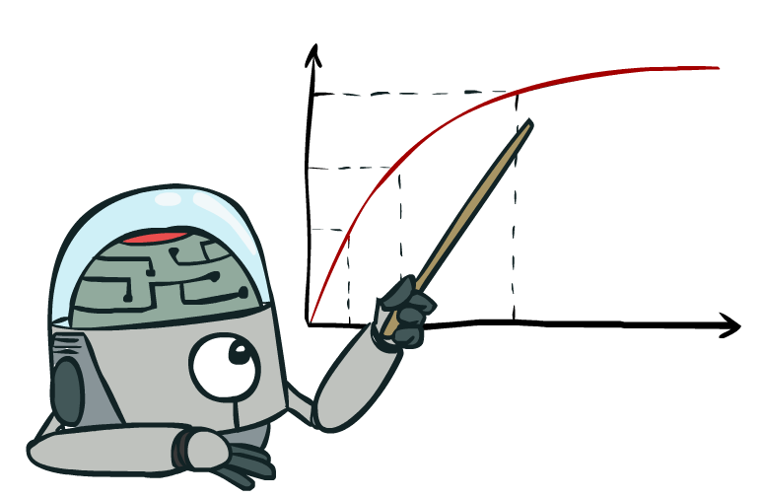
Maximize Your
Expected Utility
Notes:
Distill course to maximize expected utility.
Maximize: Consequences of an action, context, other actors around
Expected: rationality not about being successful – doing the right thing on average
Utility: What is a utility? Benefit
Your: Very end – who is your? How do you get that?

Slide 12
Maximize Your Expected Utility
Distill course to maximize expected utility.
Maximize: Consequences of an action, context, other actors around
Expected: rationality not about being successful – doing the right thing on average
Utility: What is a utility? = benefit or goals
Your: Very end – who is your? How do you get that?

Slide 13
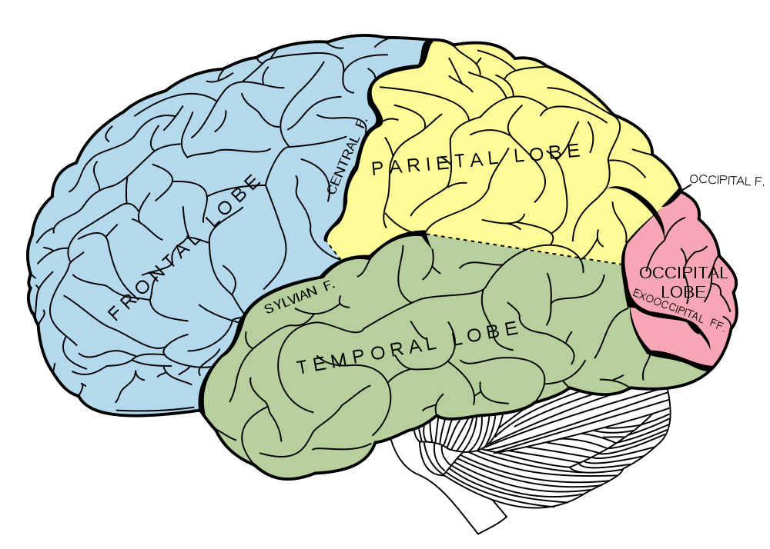
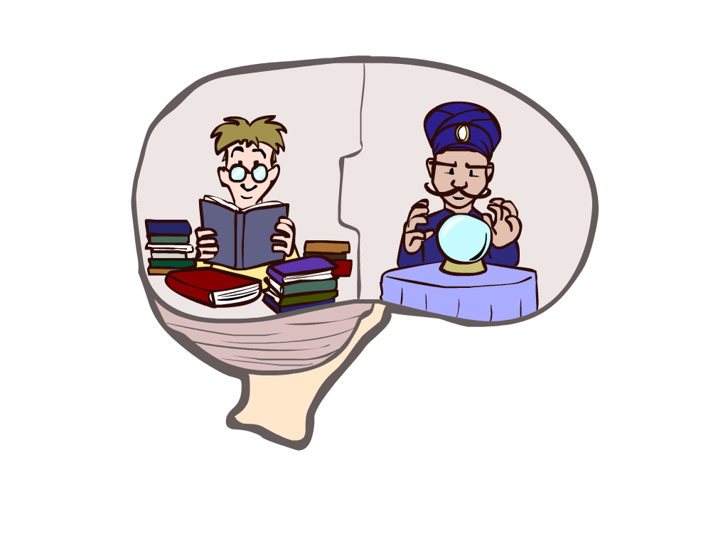
What About the Brain?
Brains (human minds) are very good at making rational decisions, but not perfect.
Brains aren’t as modular as software, so hard to reverse engineer!
“Brains are to intelligence as wings are to flight”
Lessons learned from the brain: memory and simulation are key to decision making
Notes:
Stopped making wings that flap

Slide 14
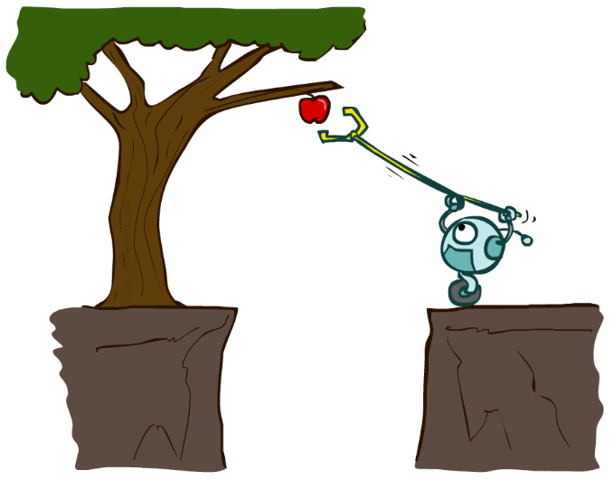
Designing Rational Agents
An agent is an entity that perceives and acts.
A rational agent selects actions that maximize its (expected) utility.
Characteristics of the percepts, environment, and action space dictate techniques for selecting rational actions
This course is about:
General AI techniques for a variety of problem types
Learning to recognize when and how a new problem can be solved with an existing technique
Sensors
Agent
Percepts
Environment
?
Actuators
Actions

Slide 15
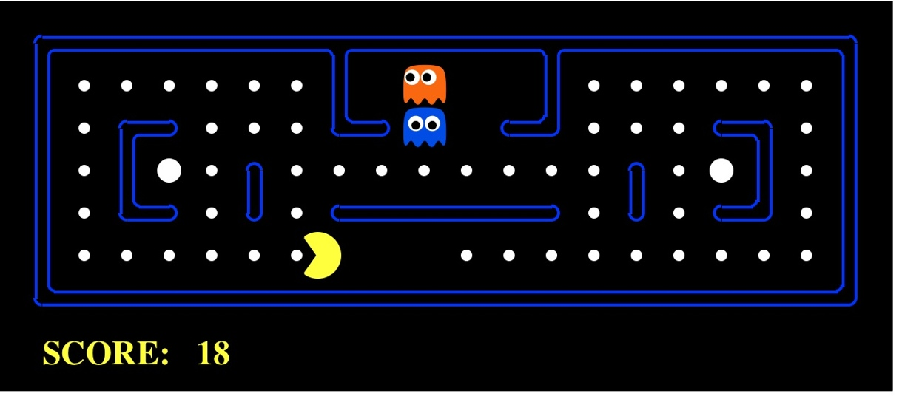
Pac-Man as an Agent
Agent
Environment
Sensors
Percepts
?
Actuators
Actions
Demo1: pacman-l1.mp4 or L1D2
Pac-Man is a registered trademark of Namco-Bandai Games, used here for educational purposes
Notes:
L1D2 =
python demos.py
Select Lecture 1 → select demo 2

Slide 16
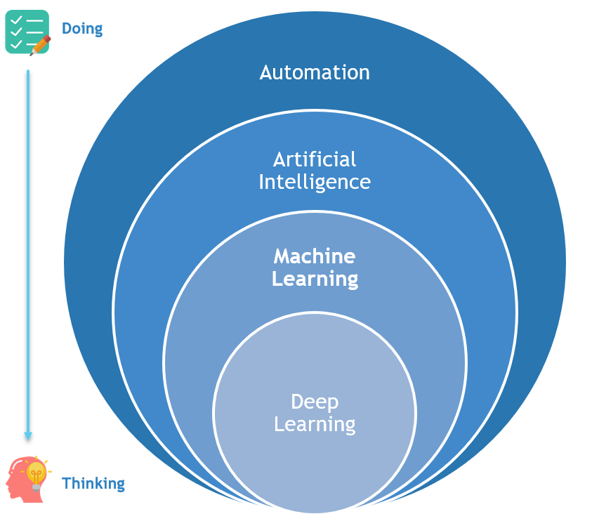
AI
Notes:
Google maps route planning – not physically embodied
Independent decisions: typical ml prediction, e.g. spam filtering

Slide 17
The Foundations Of Artificial Intelligence
The disciplines that contributed ideas, viewpoints, and techniques to AI.

Slide 18
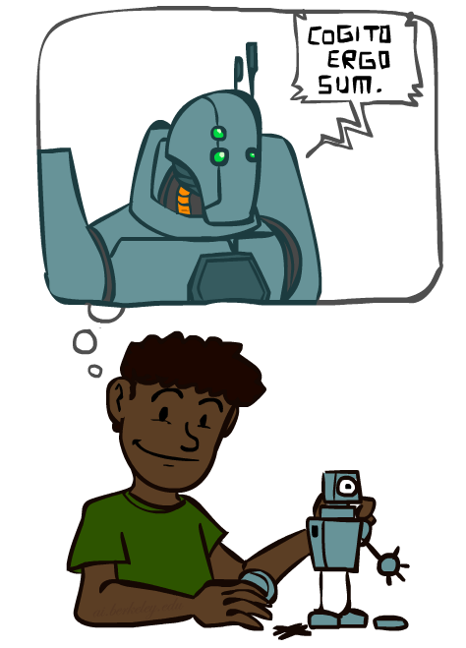
A (Short) History of AI
The Thinking Machine:
– short movie
https://youtu.be/aygSMgK3BEM
– complete movie
https://youtu.be/5YBIrc-6G-0

Slide 19
A (Short) History of AI
1940-1950: Early days
1943: McCulloch & Pitts: Boolean circuit model of brain
1950: Turing's “Computing Machinery and Intelligence”
1950—70: Excitement: Look, Ma, no hands!
1950s: Early AI programs, including Samuel's checkers program, Newell & Simon's Logic Theorist, Gelernter's Geometry Engine
1956: Dartmouth meeting: “Artificial Intelligence” adopted
1965: Robinson's complete algorithm for logical reasoning
1970—90: Knowledge-based approaches
1969—79: Early development of knowledge-based systems
1980—88: Expert systems industry booms
1988—93: Expert systems industry busts: “AI Winter”
1990—: Statistical approaches
Resurgence of probability, focus on uncertainty
General increase in technical depth
Agents and learning systems… “AI Spring”?
2000—: Where are we now?
Notes:
Million dollar computer with less computation than your phone
MT was

Slide 20
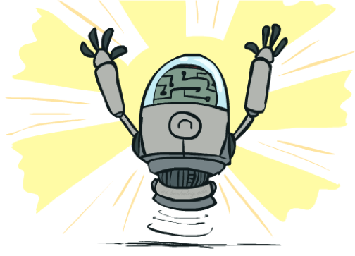
What Can AI Do?
Quiz: Which of the following can be done at present?
Play a decent game of table tennis?
Play a decent game of Jeopardy?
Drive safely along a curving mountain road?
Drive safely along Telegraph Avenue?
Buy a week's worth of groceries on the web?
Buy a week's worth of groceries at Berkeley Bowl?
Discover and prove a new mathematical theorem?
Converse successfully with another person for an hour?
Perform a surgical operation?
Put away the dishes and fold the laundry?
Translate spoken Chinese into spoken English in real time?
Write an intentionally funny story?

Slide 21
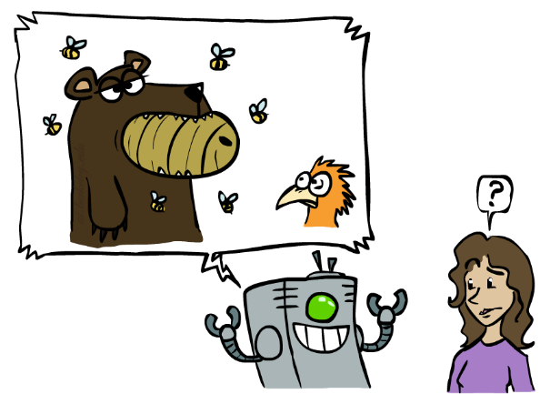
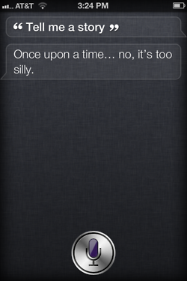
Unintentionally Funny Stories
Once upon a time the Joe bear was hungry. He asked his friend Irving bird where some honey was. Irving told him there was a beehive in the oak tree. Joe walked to the oak tree. He ate the beehive. The End.
Henry Squirrel was thirsty. He walked over to the river bank where his good friend Bill bird was sitting. Henry slipped and fell in the river. Gravity drowned. The End.
[Shank, Tale-Spin System, 1984]
Notes:
1 – physically wrong, shouldn’t eat beehive
2 – forgot that in drowning not the force is most important but the drownee
3 – not physically wrong, not wrong in a language way, but wrong in the sense that it’s not aware of what is relevant to communicate and what is not
Siri – is that progress?

Slide 22
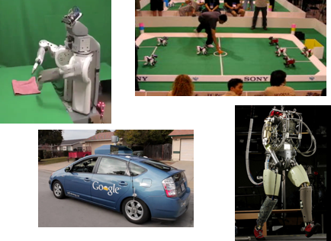
The state of art of AI: Robotics
Demo 1: ROBOTICS – soccer.avi
Demo 4: ROBOTICS – laundry.avi
Demo 2: ROBOTICS – soccer2.avi
Demo 5: ROBOTICS – petman.avi
Demo 3: ROBOTICS – gcar.avi
Robotics
Part mech. eng.
Part AI
Reality much
harder than
simulations!
Technologies
Vehicles
Rescue
Soccer!
Lots of automation…
In this class:
We ignore mechanical aspects
Methods for planning
Methods for control
Images from UC Berkeley, Boston Dynamics, RoboCup, Google

Slide 23
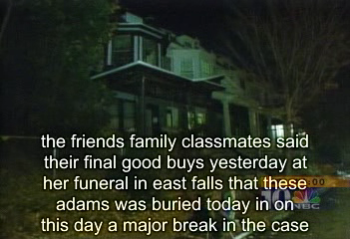
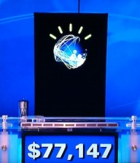
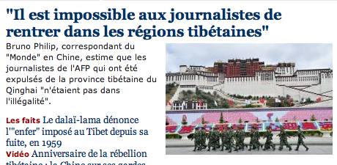
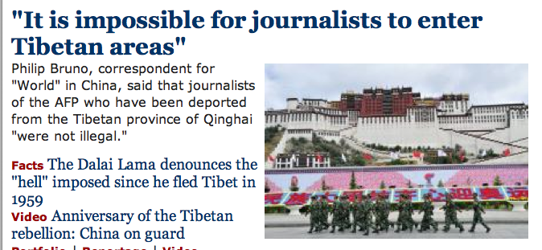
The state of art of AI: Natural Language
Speech technologies (e.g. Siri)
Automatic speech recognition (ASR)
Text-to-speech synthesis (TTS)
Dialog systems
Language processing technologies
Question answering
Machine translation
Web search
Text classification, spam filtering, etc…

Slide 24
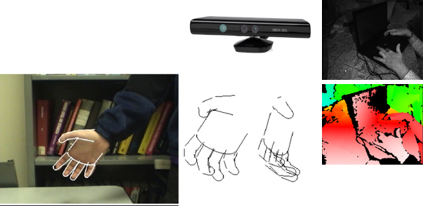
The state of art of AI: Vision (Perception)
Object and face recognition
Scene segmentation
Image classification
Demo1: VISION – lec_1_t2_video.flv
Images from Erik Sudderth (left), wikipedia (right)
Demo2: VISION – lec_1_obj_rec_0.mpg

Slide 25
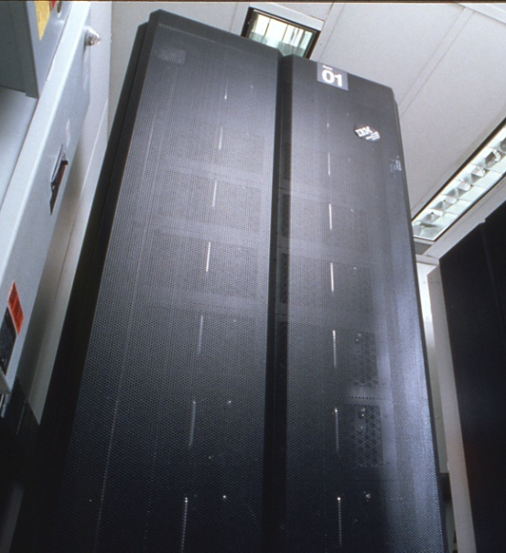
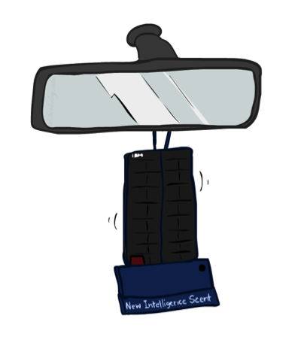
The state of art of AI: Game Playing
Classic Moment: May, '97: Deep Blue vs. Kasparov
First match won against world champion
“Intelligent creative” play
200 million board positions per second
Humans understood 99.9 of Deep Blue's moves
Can do about the same now with a PC cluster
Open question:
How does human cognition deal with the
search space explosion of chess?
Or: how can humans compete with computers at all??
1996: Kasparov Beats Deep Blue
“I could feel --- I could smell --- a new kind of intelligence across the table.”
1997: Deep Blue Beats Kasparov
“Deep Blue hasn't proven anything.”
Text from Bart Selman, image from IBM’s Deep Blue pages
Notes:
Yeah, Kasparov comment probably says more about humans than about computers

Slide 26

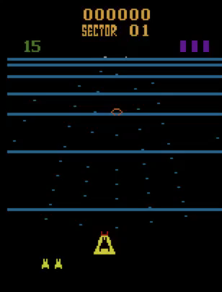
The state of art of AI: Game Agents
Reinforcement learning
Pong
Beamrider

Slide 27

The state of art of AI: Decision Making
Applied AI involves many kinds of automation
Scheduling, e.g. airline routing, military
Route planning, e.g. Google maps
Medical diagnosis
Web search engines
Spam classifiers
Automated help desks
Fraud detection
Product recommendations
… Lots more!
Notes:
All applications can be thought of as decision making or useful sub-components of decision making

